Slide 1


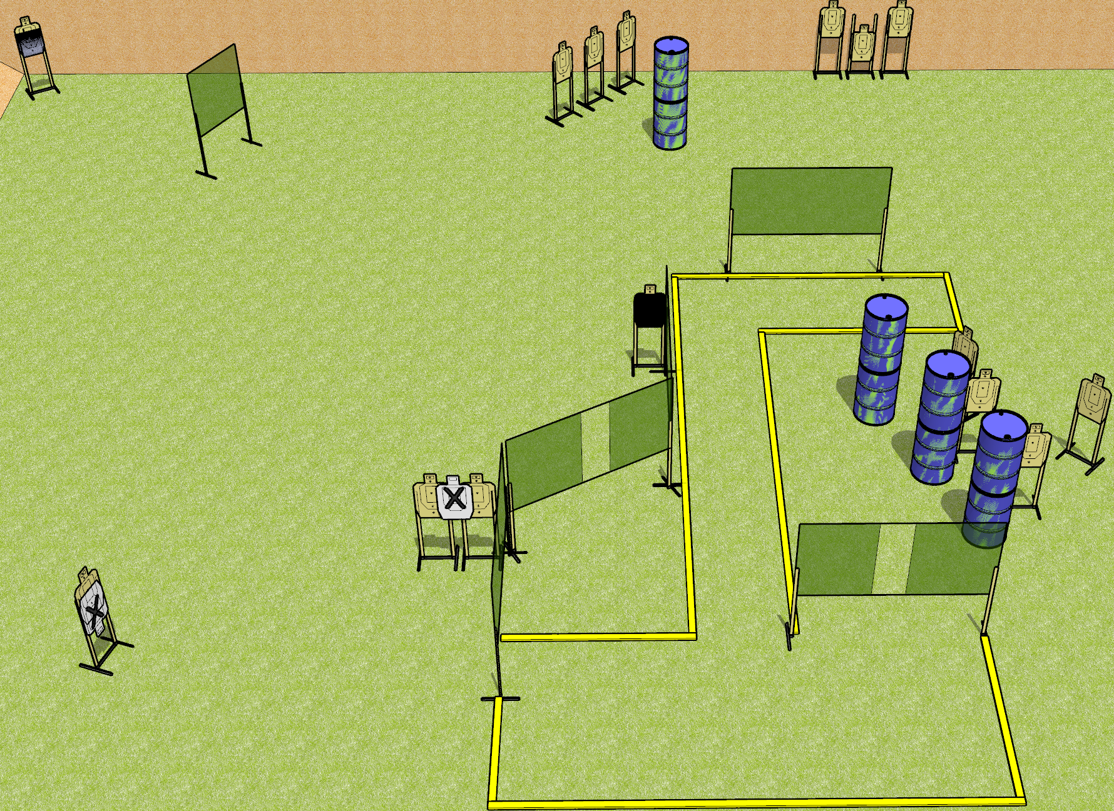
 | Dothan Gun Club – USPSA Match Aim Small Miss Small Course Designer : Drew Coleman
Round Count 30 rounds 15 USPSA targets
Equipment List Upper left target – Action target, hard cover is 5” down from shoulder perf 12 wall feet (SETUP NOTE) – the upper left target should be 20-25 yards from the positions it can be engaged from

Slide 2
Aim Small Miss Small
Written Stage Briefing
Aim Small Miss Small is a 30 round, 150 point, Comstock field course. There are 15 USPSA targets. The best 2 hits on paper will score. The start signal is audible.
Handgun start position is anywhere completely outside the shooting area, wrists below belt. Handgun is loaded and holstered.
PCC start position is anywhere completely outside the shooting area. Loaded carbine is held with both hands, stock on belt, safety on.
On start signal, engage targets as they become available from within the shooting area.

